Slide 1
COLLEGIFY
By:- Guided By:-
HItanshu PANCHAL (1680026) Mr. PRATIK SHAH
DHRUWNAGI SHROTRIYA(1680054) TECHNICIAN:-
PRIYANKA WALEKAR (1680056) Mr. CHETAN DESAI

Slide 2
INDEX
Need of Collegify
Introduction
Modules
Existing Solutions//
Our Solutions//
Technological Requirements
Literature Survey
System Design
Libraries
Results//
Features
Limitations
Applications
Future Scope
Conclusion
References

Slide 3
NEED OF COLLEGIFY
Different Courses a College provides
Way to contact the Colleges
Colleges that are near to them
Parents/Students wants to know…
Infrastructure and Reviews of the Colleges
Directions to the College
Easy Access to Information of the Needed Colleges

Slide 4
INTRODUCTION
Android application over websites
In-app services
Filter Colleges according to fields
Search for required Colleges
Address and directions to the colleges
Nearby Colleges around the user
Direct link to the website and contact number of Colleges
Ability to bookmark the College
Provide and refer the reviews of Colleges
Nearby Bus Stops to the Colleges
Beneficial to new residentials to Mumbai
Information provided in more organized manner.

Slide 5
Modules
Login Module
College Information Module
Google Places Module
Filter Module

Slide 6
HARDWARE AND SOFTWARE REQUIREMENTS
Mobile Phone
Should be an Android powered phone.
API version should be 19 (KitKat) or above.
Should have an Internet Connection.
For Development
Microsoft® Windows® 7/8/10 (32- or 64-bit).
3 GB RAM minimum.
2 GB of available disk space minimum.
1280 x 800 minimum screen resolution.
I3 Processor or higher.

Slide 7
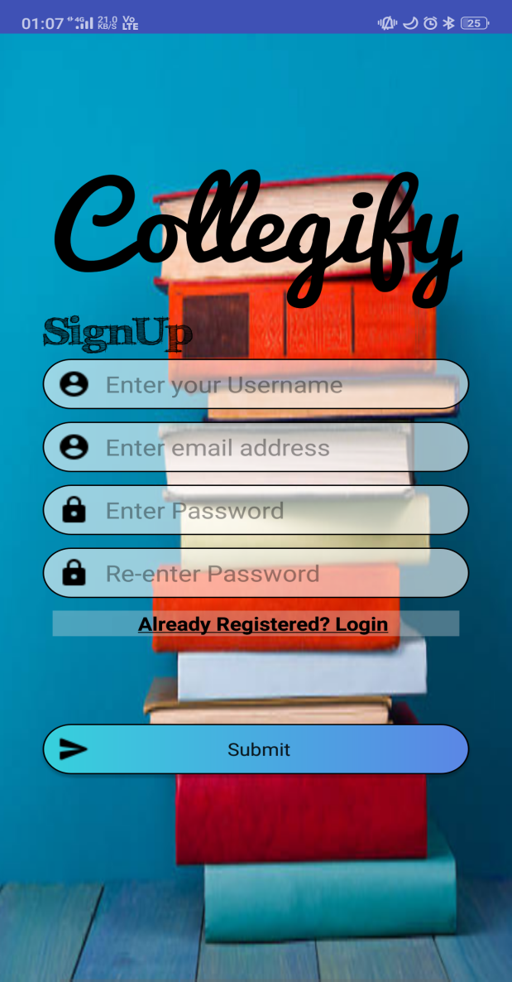
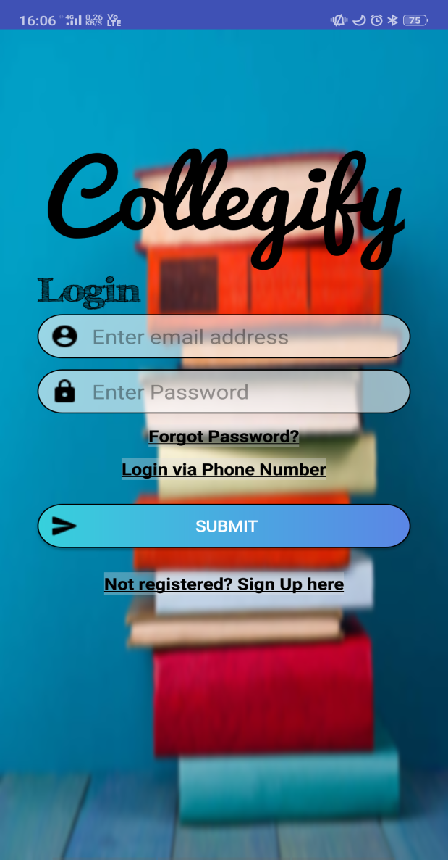
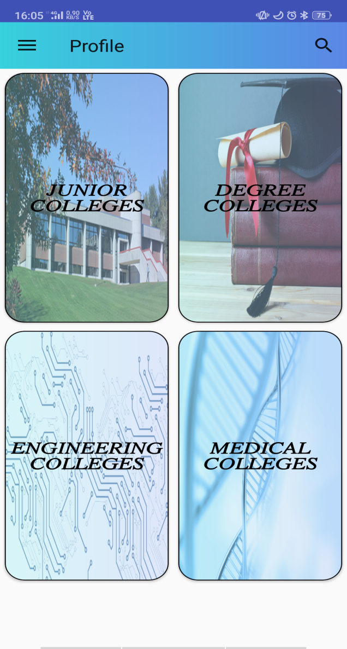

Slide 8
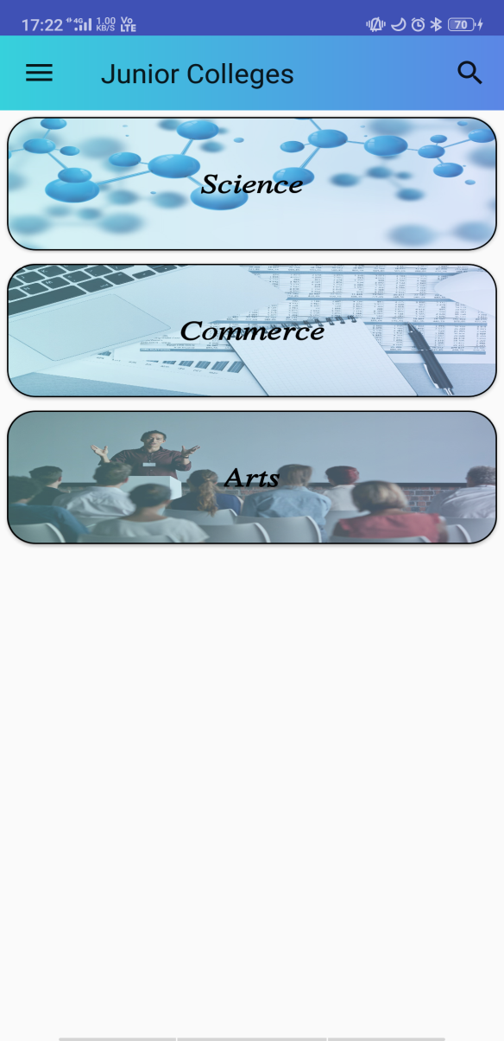
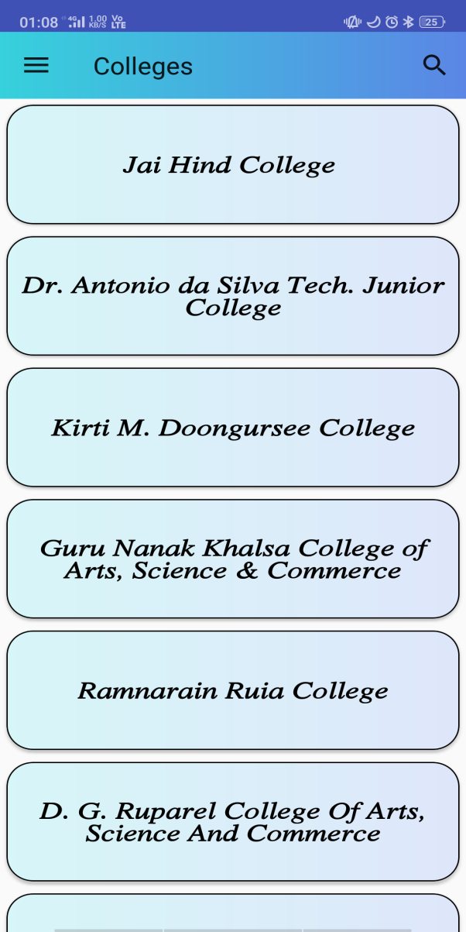
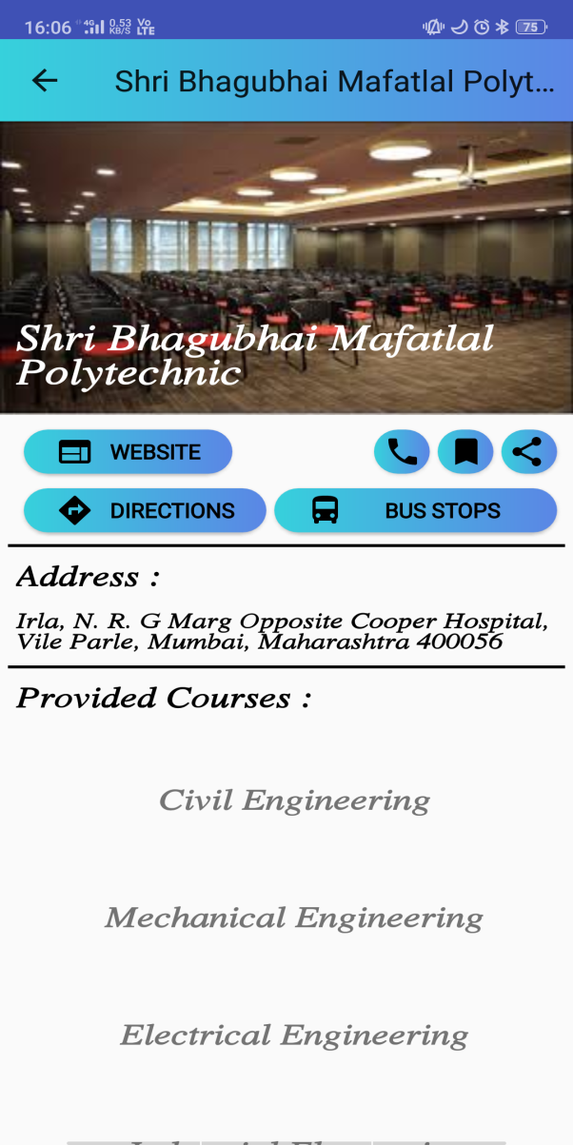

Slide 9
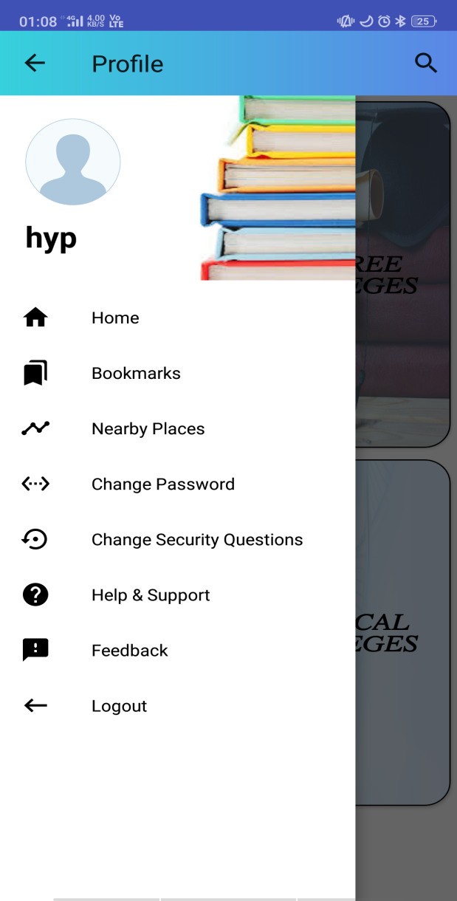
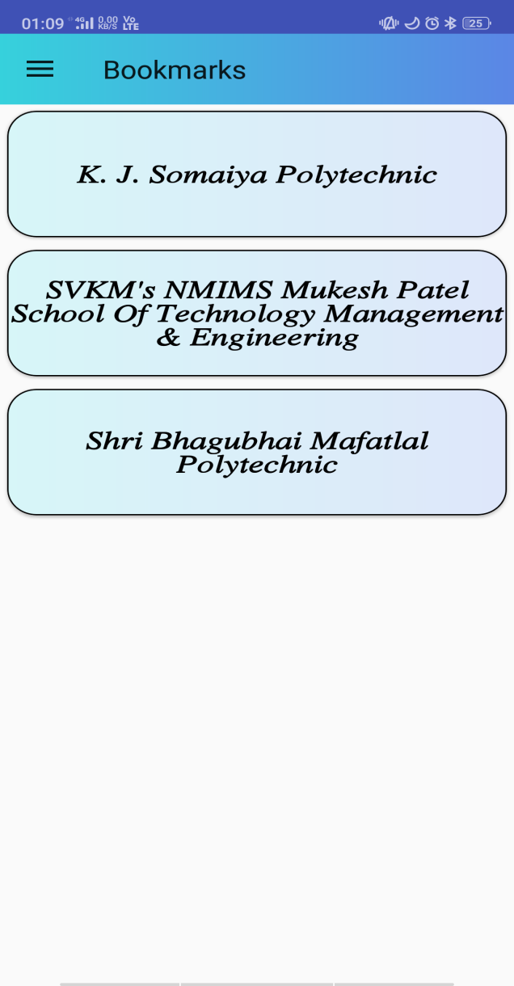
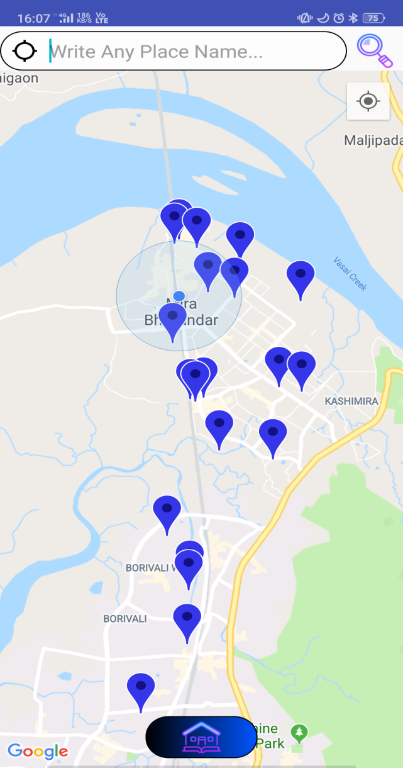

Slide 10
